Slide 1



New Joiner Orientation

Slide 2
AGENDA
Company Overview
Company Vision & Organization
Career Path & Performance Review
Policies
Benefits
Email Setup
Timesheet

Slide 3
AGENDA
Company Overview
Company Vision & Organization
Career Path & Performance Review
Policies
Benefits
Email Setup
Timesheet

Slide 4

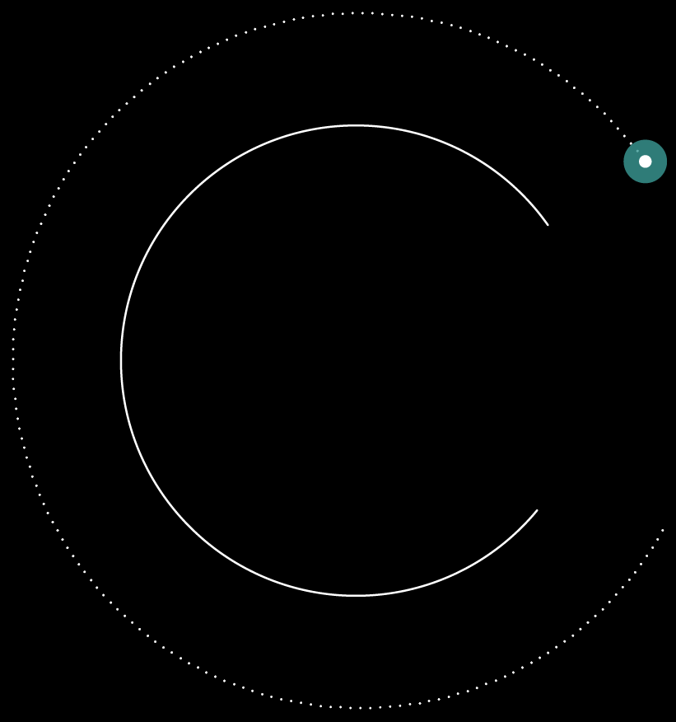







FOUNDED IN
2004
We are a niche provider of technology
consulting delivering a range of solutions
across industries, with an experience
from international consulting firms.

Slide 5












Project
Consumer
Food
Resource
Retail
Automobile
Transportation
Telecom
Insurance
Banking

Slide 6


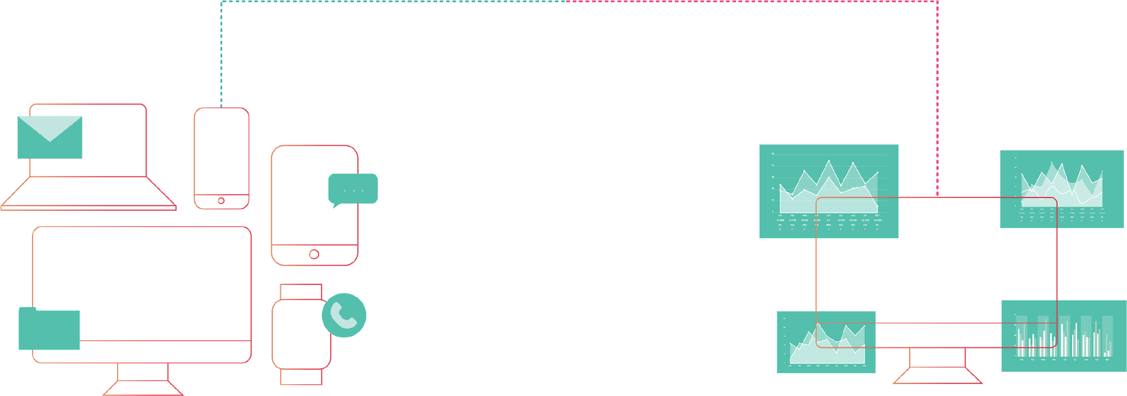
































Big Data, Data Warehouse,
Business Intelligence
and Data Science
2 out of 3 telco
4 out of 6 banks
3 out of 3 life insurance
petabyte of data
many assets in data framework
BIG DATA
SOCIAL, SYSTEM, more…
BI&REPORT, FORECASTING, DASHBOARD
Real-time & ETL/ELT
Appliance & Others
Cloud DB
Virtualization & Visualization
Data Science
Traditional RDBMS
Hadoop

Slide 7







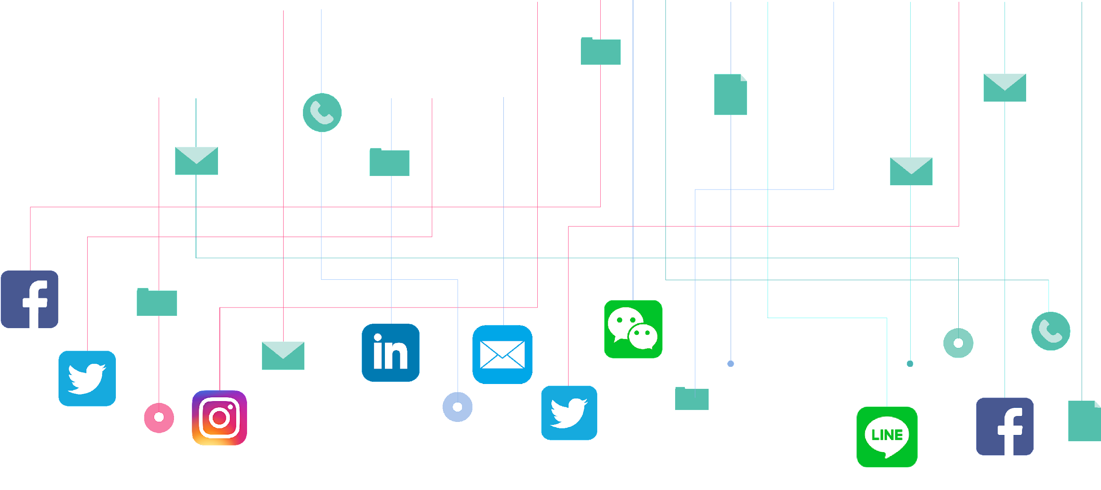



Marketing Solutions
Turn a traditional campaign into
an innovative marketing.
SEO Improvement
Omni-Channel Realtime&Batch Campaign Automation
Turn unknow visitors to segments (DMP)
Web Analytics & Session Replay
Digital Assets Management

Slide 8
























































Our Clients
Financial
Insurance
Telecom
Others
Retails
Petro & Energy
Transportation

Slide 9

Current Projects

Slide 10
AGENDA
Company Overview
Career Path & Performance Review
Company Vision & Organization
Policies
Benefits
Email Setup
Timesheet

Slide 11
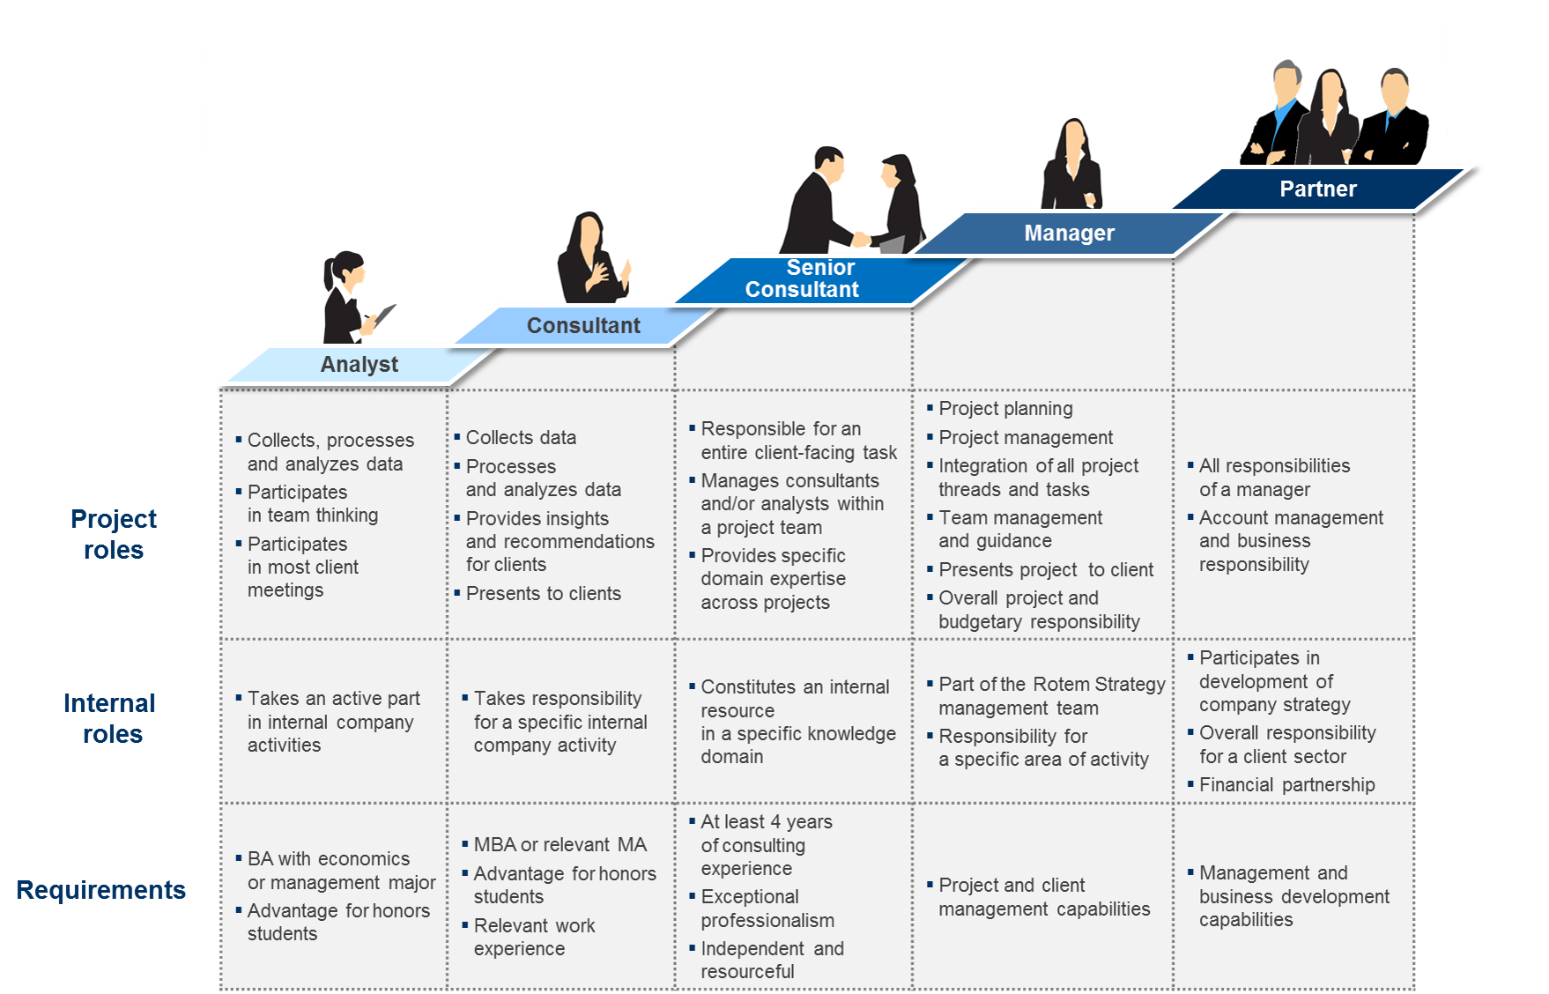
Career Path
0-4 years
4-7 years
7-10 years
10+ years

Slide 12
Analyst Role
A. Contributions to project assignments
1. using proven methods, tools, and techniques.
2. utilizing knowledge, and techniques required by the assignment
3. solving problems in daily business and operation
B. Contributions to team (members)
4. performing duties as your supervisor instruct
5. working with supervisor and end-users to understand client’s needs
6. assisting your supervisor to interview clients, conducting studies, gathering, interpreting, and using complex data to develop actionable steps that will improve processes and optimize results
C. Relationship with clients
7. keeping positive working environment with clients.
8. keeping lines of communication open with clients in order to gain a better understanding of their needs and expectation.

Slide 13
Consultant Role
A. Contributions to project assignments
1. designing, planning, and implementing information technology solutions for clients.
2. determining the requirements of an assignment objectives.
3. preparing test plan, test scripts for system testing, functional testing and implement the plan.
4. providing support for activities related to data conversion and resolving any issues occurring.
B. Contributions to team (members)
5. reviewing tasks performed by analysts as well as coaching and supporting their morale.
6. on-the-job training and coaching consultants and analysts
C. Relationship with clients
7. Able to lead client meeting with support from supervisor
8. Able to provide non-complex solution for customer

Slide 14
Sr. Consultant Role
A. Contributions to project assignments
1. interpreting and formulating conclusions that lead to solutions.
2. Developing both technical and business solutions for client situations to meet goals and objectives.
3. Managing knowledge / experience sharing within the team
4. Able to manage small project size of 2-3 people
B. Contributions to team (members)
5. helping project manager to develop work plans and coordinate daily fieldwork and project team efforts.
6. Coaching and supporting team member to improve performance as a team.
7. Able to lead business, technical, or testing team
C. Relationship with clients
8. Managing project scope and expectations.
9. Able to provide high-level complex solution for customer
10. Professional presentation of issue/problem with suggested solutions to clients

Slide 15
Manager Role
Role Summary
Project Manager
Managing a team of 10+ resources, supervising team members through monitoring daily business and operation, with effective and timely direction and suggestion
Supporting and coaching team members by solving technical and operational problems based on own experiences and having a general expertise in a specific area
Solution Manager
Design solution architect and recommend appropriate tools or systems to meet customer need and expectation.
Having technical expertise knowledge in more than one area of data consultation e.g., data engineering, data science, BI, etc to support team

Slide 16
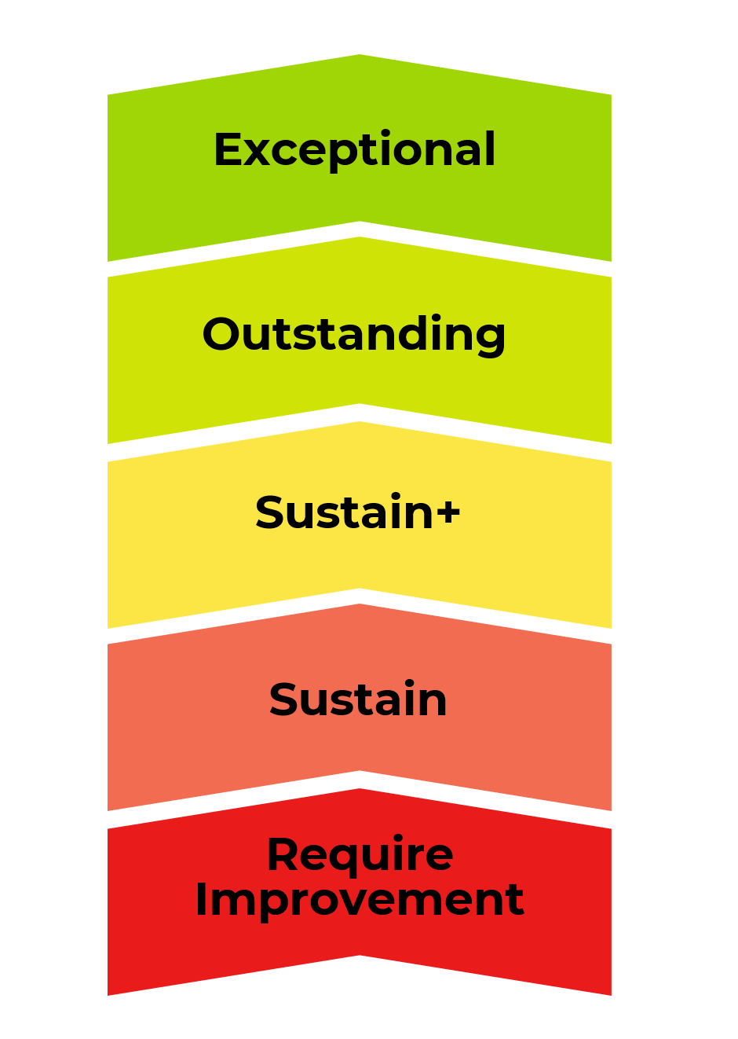
Performance Review & Scoring
April
August
December
April, August : intra-year review
December : year end review
1. Exceptional : There’s only few people. In order to get, you must perform at exceptional level way beyond what you were assigned to.
2. Outstanding : There’s around 5-10%. In order to get, you must perform very well.
3&4. Sustain and Sustain Plus : If you can perform according to your assigned with a bit of + and -, you’ll get rating as ”Sustain”. Then x% of the top Sustain will get Sustain Plus.
5. Require Improvement: If you cannot perform according to your role or making so many mistakes, you might be rating at this level which will result on your benefits next year.

Slide 17
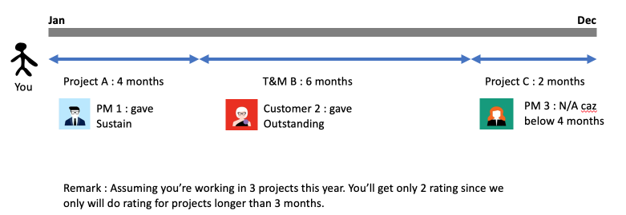
Performance Review

Slide 18
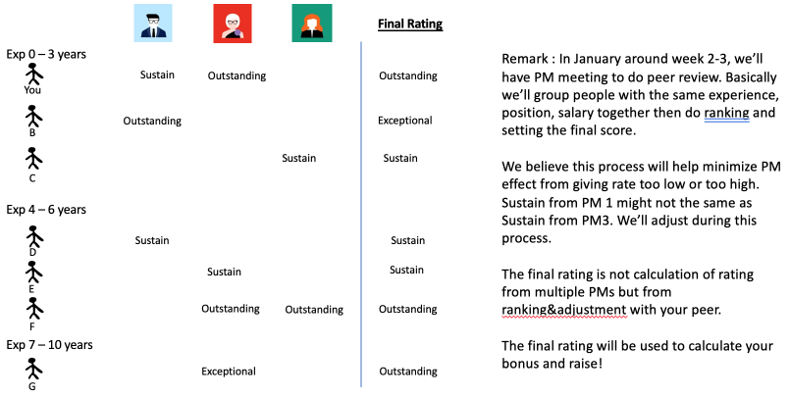
Bonus & Salary Raise: Review Process
PM1 PM2 PM3

Slide 19
Salary and Bonus
Fiscal year start January
Bonus will be paid end of January* *for tax management purpose
New salary will be effective in January
Bonus and Salary Raise will be applicable for those who joined by September 1st of the previous year

Slide 20
FAQ
Question: I work in one project; the rating from either PM or Customer is my final rating?
Answer : No. PMs and Customers have different standard. That’s why we have PM meeting to make sure rating is align with each other.
Question: I got different rating from multiple PMs, do you calculate my final rating from average the score?
Answer: No. The final score will base on PM meeting as in previous slide.
Question: I worked under T&M. Feedback from customer is my final rating?
Answer: No. Customer normally over rate. So our PM will discuss with customer to understand more and adjust. The final score will base on PM meeting as in previous slide.

Slide 21
FAQ
Question: Do I know who’s my peer that I compare with?
Answer : It’s best interest for you to not know. But all PMs are trying best to be fair comparison.
Question: I’m under probation (under 4 months), do I get raise & bonus?
Answer: No.
Question: I’m not working full 12 months. Do I get bonus?
Answer: Yes but it’ll prorated bonus.

Slide 22
FAQ
Question: I got rating the same as last year. My bonus and salary raise will be the same as last year?
Answer: No. It may be below, above or the same. Bonus is based on performance of that year then calculate based on performance of individual.
Salary Raise is based on company outlook of NEXT year and market rate. So it’s very different year by year.

Slide 23
AGENDA
Company Overview
Career Path & Performance Review
Company Vision & Organization
Policies
Benefits
Email Setup
Timesheet

Slide 24
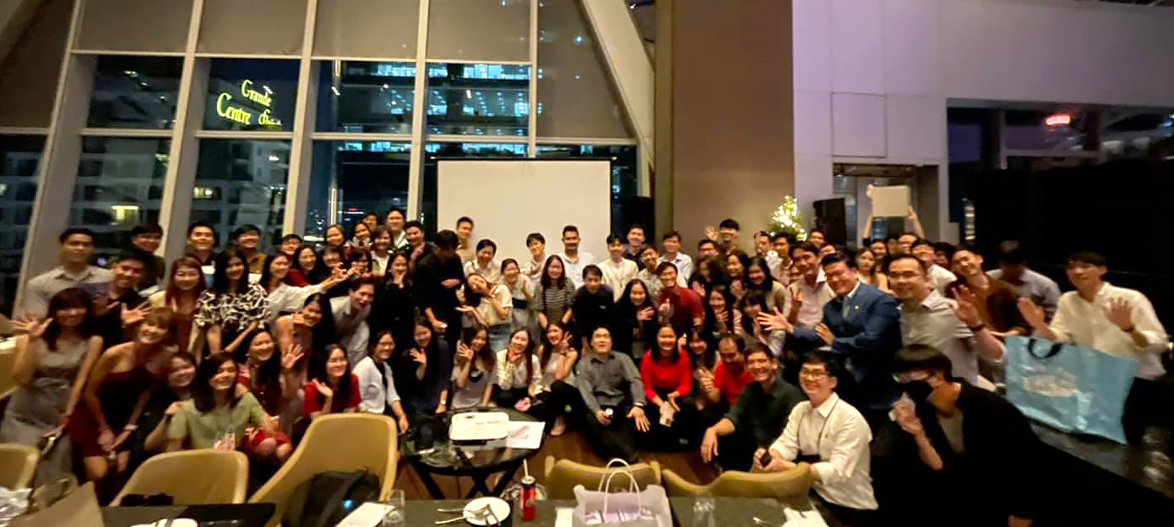
Inteltion’s Vision
“No 1 Data Evolutionizing Consultant in Thailand”

Slide 25
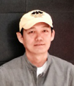
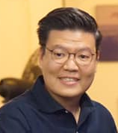
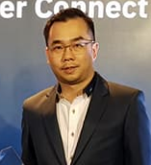
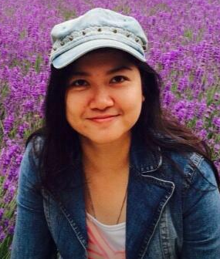
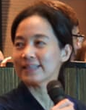
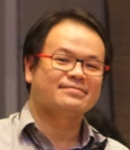
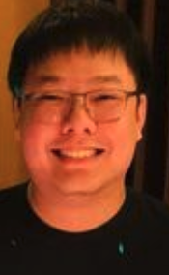

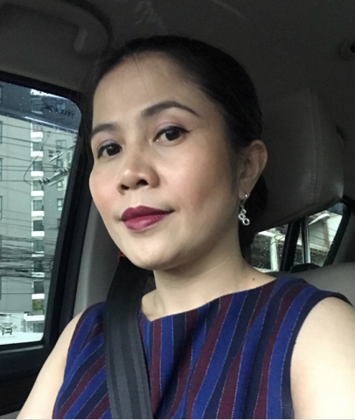
Inteltion Organization
Tao – Kittipong T.
Pop –Suwaphon S.
Partner & Founder
Founder
Tee –Peeradej P.
Nui –Untikar C.
Partner
Partner
Consultant Team
Sales Team
Back Office Team
Som – Phatikorn T.
Keng- Suragard S.
Mo - Kitti R.
Mali – Malilynn P.
Maew – Sompit S.
PM / Partner
PM / Partner
SM / Partner
Head Sales
Head BO
Project Manager
Solution Manager
Senior Consultant
Consultant
Analyst
Contractor
Sales Managers
Sales Junior
Presales
Accounting
Admin
HR

Slide 26
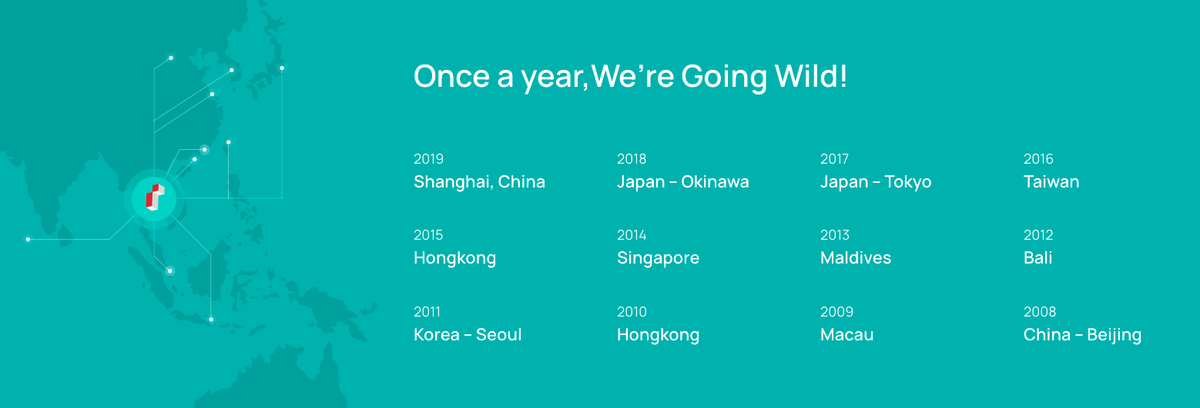
Play Harder

Slide 27
AGENDA
Company Overview
Career Path & Performance Review
Company Vision & Organization
Policies
Benefits
Email Setup
Timesheet

Slide 28
Inteltion Policy
Confidential and PDPA: Customer confidential is the most important and it’s part of every contracts. Don’t share outside company, especially social!
Non-Solicitation: In every projects, we have contract not to hunt people from each other within project and 1-3 year after!
Projects are tough but have fun: We’re Open-Door policy! You can talk to any one any time.

Slide 29
AGENDA
Company Overview
Career Path & Performance Review
Company Vision & Organization
Policies
Benefits
Email Setup
Timesheet

Slide 30


INTELTION
Member get member
Program 2022
Evolutionizing your business.

Slide 31







Statistic of Member get member Program 2022 (Jan – May)
Over 500,000 THB will reward in total
Highest reward 100,000THB to a referrer
Average reward 23,000THB per referrer

Slide 32



We’re running member get member campaign for the whole year. So, if you can refer anyone to work with us, you’ll get referral fee as below, after passing probation (4 months).
Exceptional : 100,000 THB
Outstanding : 70,000 THB
Sustain & Sustain Plus : 20,000 THB
Contractor : 10,000 THB

Slide 33

Certificates Reward
We are encouraging people to take certificates. Each time you certified you will be award for 1,000 THB per certificate ( Maximum 3 certificates per year)
Certificates that you take should be related to our service and product such as Azure, AWS, Adobe etc.

Slide 34
Transportation Expense
If you work at the client’s site, you’re eligible to claim for transportation expense using formula below
Claim = | (Trans. Exp. from home to client’s) | – | (Trans. Exp. from home to Inteltion’s office)
For example,
Case 1
Transportation Expense from home to client’s = BTS (30THB) + Motorcycle (15 THB)
Transportation Expense from home to Inteltion’s office = BTS (20)
Claim = 45 – 20 THB
Case 2
Transportation Expense from home to client’s = Motorcycle (15 THB)
Transportation Expense from home to Inteltion’s office = BTS (45)
Claim = you cannot claim expense
Reimbursement procedure;
Please fill the details in Timesheet and send to PM or supervisor to approve before the 4th of each month.
The company will reimbursement to you on 25th of each month.

Slide 35
Leave
Employees are entitled to take leave as specific below
Vacation leave of 15 days at maximum by annual calendar (pro rata basic).
Can use after passing probation period.
At the end of the year, unused vacation leave will turn into cash based on your salary = [[salary] x [remaining vacation]] /20
If you’re uncharged, company has right to ask you to take vacation leave.
Only 50% of vacation days can turn into cash.
Sick leave of 30 days at maximum by annual calendar (pro rata basic).
If the sick leave absence is more than 1 day, employee is required to provide a Medical Certificate from an approved hospital.
Business leave of 3 days at maximum for matters that cannot be scheduled outside regular hours (ลากิจสามารถใช้ได้เฉพาะการติดต่องานราชการที่ต้องไปด้วยตัวเองเท่านั้น เช่น ทำบัตรประชาชน)
When taking leave, please inform customer/PM in your project via e-mail and put admin@inteltion on CC.

Slide 36
Providence Fund
Providence Fund is provided which will deduct 5%,10%,15% (It depends on your) from your salary every month while company will top up another 5%. The deduction will start after passing probation period.
Joining company more than 5 years will eligible for company top up portion. Otherwise, you’re entitled for your 5% portion only.

Slide 37
Flexible Fund
Flexible Fund: Employees are entitled to claim for education & health expenses (pro rata basic). Flexible Fund will eligible after passing probation at 10,000 THB/Year
All payment will be paid to you on 25th of each month. You’ll need to record the expenses in Time & Expenses sheet along with INVOICE under Inteltion name.
บริษัท อินเทลชั่น จำกัด
408/55 อาคารพหลโยธินเพลส ชั้น14
ถ.พหลโยธิน แขวงสามเสนใน
เขตพญาไท กรุงเทพ 10400
Tax id : 0105547121397

Slide 38
Flexible Fund
Flexible Fund
An expendable budget for the amount of 10,000 THB/year for the following items
IT equipment or IT accessories. Amount not more than 3,000 THB per piece.
Educational course or training.
Medical and health such as fitness course, dental, and vaccine.
Remark : If bills DO NOT fit with those 3 conditions, you can still claim for flexible fund but it'll count as part of your revenue.
You will need to submit receipt for each claim to our accounting team (You have to send soft copy of receipt to admin@intelion as soon as possible)
If bills fit with those 3 conditions require receipt under Inteltion name
If bills do not fil with those 3 conditions require receipt under your personal name

Slide 39
Group Insurance
After passing probation period, you will get insurance card
OPD 1,500 THB 1 per day / 30 days per year
IPD 2,000 THB
ER 7,500 THB
Hospital Expense, Surgery, and other will adjust yearly

Slide 40

Group Insurance

Slide 41
Benefit Table
 | Below 5 years | 5 Year Up | 10 Years Up
Leave
Vacation | 15 | 15 | 15
Sick Leave | 30 | 30 | 30
Business Leave | 3 | 3 | 3
Insurance
OPD | 1,500 | 2,500 | 2,500
IPD | 2,000 | 2,000 | 2,000
ER | 7,500 | 7,500 | 7,500
Dental | - | 1,500 | 1,500
Extra Insurance | - | - | 
Provident Fund | 5% | 5% | 5%
Company Contribution | 0% | 100% | 100%
Flexible Benefits | 10,000 | 10,000 | 10,000

Slide 42
AGENDA
Company Overview
Career Path & Performance Review
Company Vision & Organization
Policies
Benefits
Email Setup
Timesheet

Slide 43
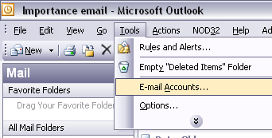
Email Configuration
There’re 2 ways to check Inteltion’s email.
Web Email: Just go to http://mail.inteltion.com if you cannot use Outlook at the client’s site.
Outlook: This approach is the mandatory approach since it’ll free up your email space. Below is how to config your Outlook
A. Open Outlook and go to Tools

Slide 44
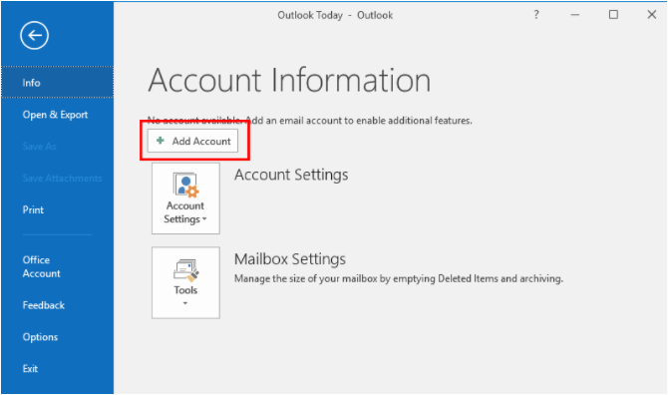
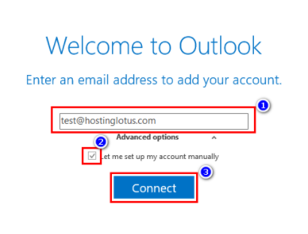
Email Configuration (Cont.)
B. Select "Add new account | C. 1. Type your Email Account 2. Check “Let me set up my account Manually 3. Click “Connect” *User Name: FirstName@inteltion.com

Slide 45
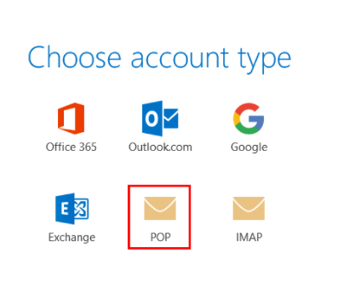
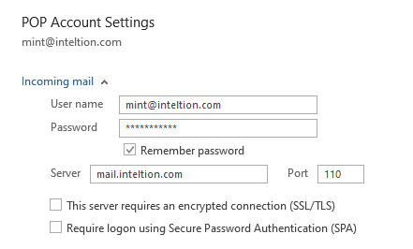
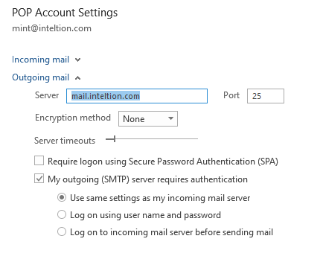
Email Configuration (Cont.)
D. Select POP | E. Incoming mail Server: mail.inteltion.com Port: 110 Outgoing mail Server: mail. inteltion.com Port: 25

Slide 46
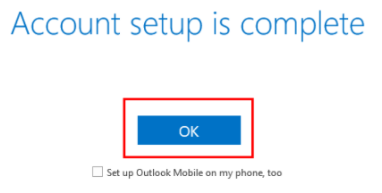
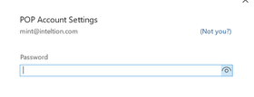
Email Configuration (Cont.)
F. Click “Connect” Type Password and click “OK” Password: P@ssword123 (You can change your password via web's email). | G. A message display “Accout Setup is complete” click “OK”

Slide 47
Email Configuration (Cont.)
H. If you don’t regularly download email to store in your Outlook notebook, you’ll have to sync your account with gmail to expand email box size. Follow step from link below
https://my.bluehost.com/cgi/help/gmail

Slide 48
AGENDA
Company Overview
Career Path & Performance Review
Company Vision & Organization
Policies
Benefits
Email Setup
Timesheet

Slide 49

How’s it work?
Staff
Approver
Admin
On 30th or 31st
By 4th of next month
By 7th of next month
At the end of the month, timesheet must be submitted to Approver.
Approver is your project lead or project manager. If no Inteltion’s lead or PM, you can approve your timesheet directly.
If you’re also Approver, you must approve all timesheet by the 4th of the month.
Admin (Accountant) will check on the 7th of the month to process claim expense.
All claims will transfer to your bank account at the end of next month.
If your timesheet is delay, you’ll need to claim your expense in next month.

Slide 50
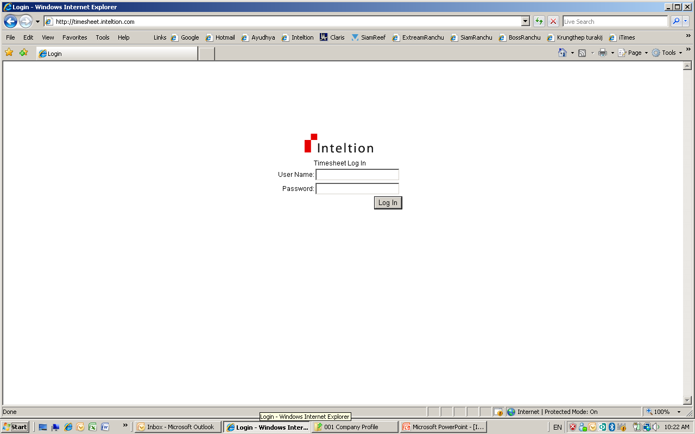
Where is iTime?
Open your IE and go to
http://timesheet.inteltion.com
2. Login to the system using your user name and password.
Note: User Name = your email such as kittipong@inteltion.com

Slide 51
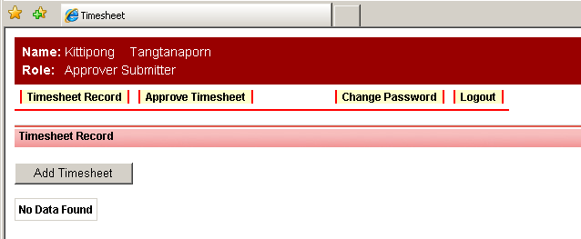
Your Default Page
You will find the menu bar on the top for you to access each page.
Timesheet Record Menu : Is for maintaining your timesheet
Approve Timesheet Menu : Will be seen by Approver only
2. Your default page is “Timesheet Record”. To add new timesheet, click “Add Timesheet” button.

Slide 52
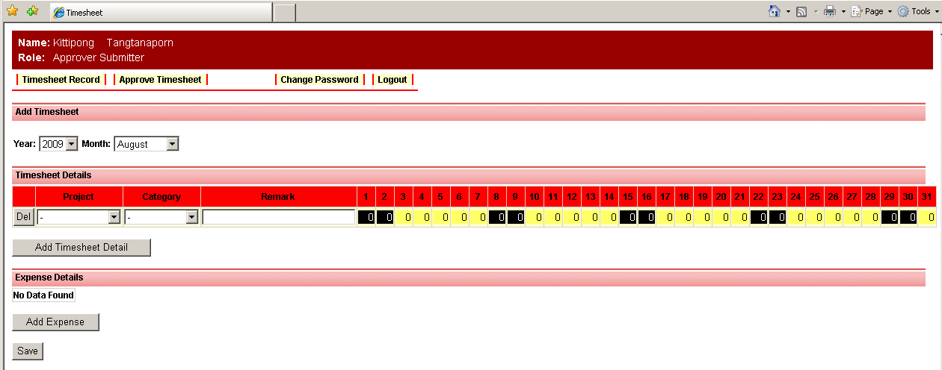
Add Timesheet (1)
Select Year and Month dropdown that you want to create new timesheet.
2. Select Project and Category Dropdown, add Remark and hour you spend in each day. To add multiple Projects or Category, click at “Add Timesheet Detail” button for new line.

Slide 53
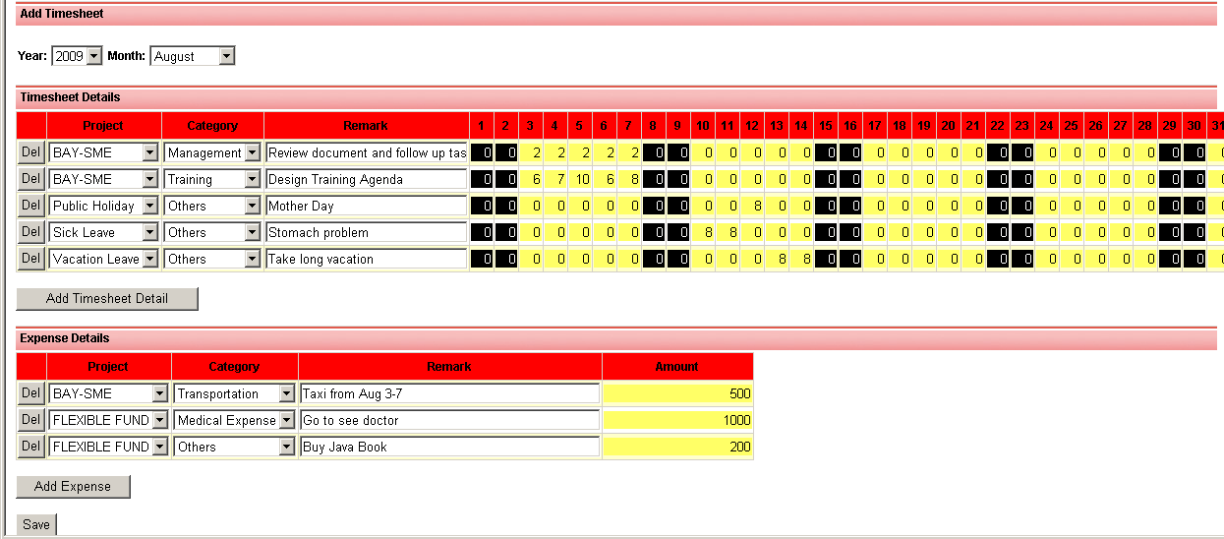
Add Timesheet (2)
All yellow background date must have value before submit.
Number is in Hour(s). Please put actual hours in each day. It can more than 8 hours per day.
If you don’t see your project name, call or email P’Tao.
For “Public Holiday”, “Sick Leave” and “Vacation Leave”, put 8 hours in that day.
2. Click “Save” button.

Slide 54
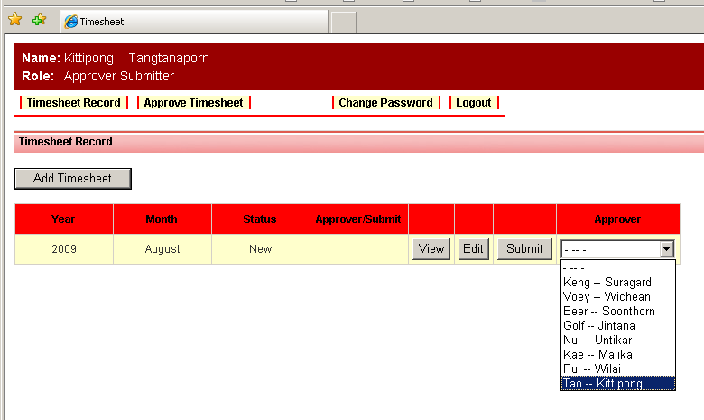
Add Timesheet (3)
1. Once ready to submit to Approver. Select your Approver name (your project lead), then click “Submit” button.

Slide 55
APPROVE TIMESHEET MENU
If you are Approver, you will need to follow up with your team to submit timesheet on-time. You will need to approve all timesheet by the 3rd of the month.

Slide 56
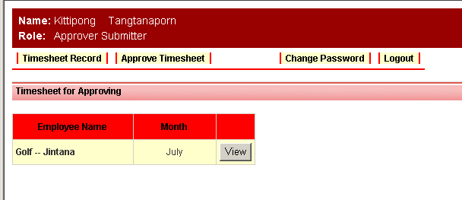
Approve Timesheet Menu (1)
1. To approve timesheet, click “View” button one by one.

Slide 57
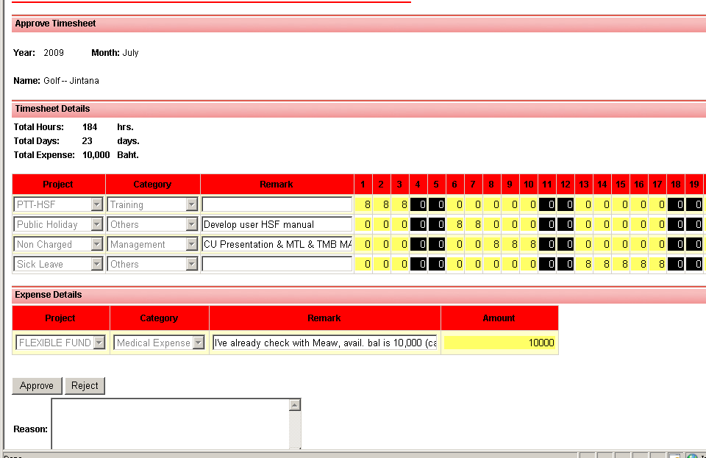
Approve Timesheet Menu (2)
1. Approver needs to review time spent in each day against actual in the project.
2. Review Expense for Category “Transportation”, match it with working days.
3. Click “Approve” to submit to Accountant
Click “Reject” and add Reason to return this Timesheet back to correct.

Slide 58




Thank you
Inteltion Co.Ltd. Phahonyotin Place 14 Fl. 408/55 Phahonyotin Road
Phayatai Samsennai Bangkok 10400 Thailand
Tel. 02 619 0209
02 619 0363
02 619 0364
Fax. 02 619 0208
Copyright to Inteltion. Proprietary and Confidential 10

